Slide 1
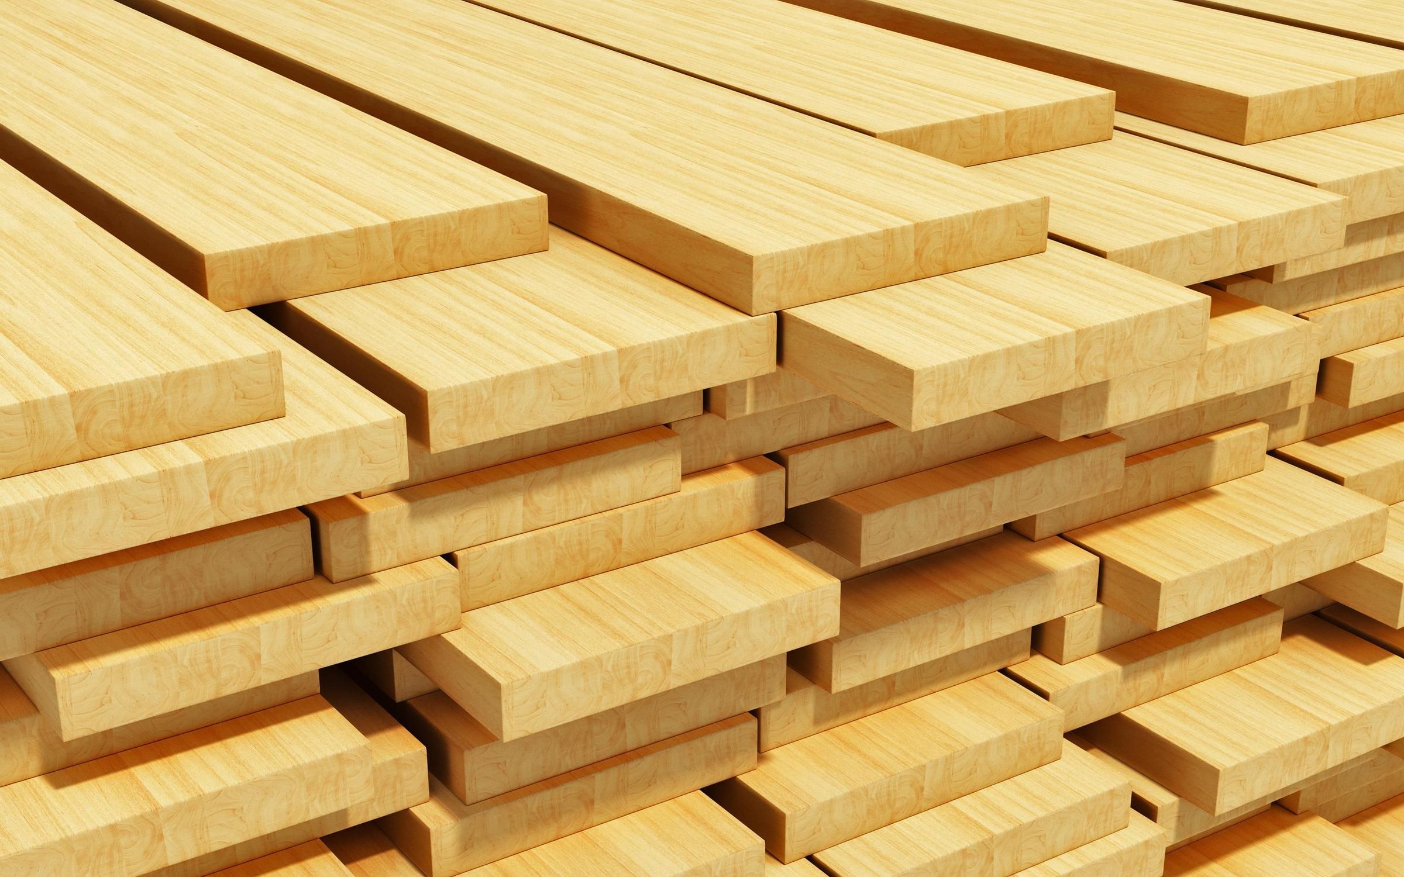
NEBULA NEXUS TRADING COMPANY W.L.L.
www.nebnexbh.com
NEBULA NEXUS TRADING COMPANY W.L.L

Slide 2
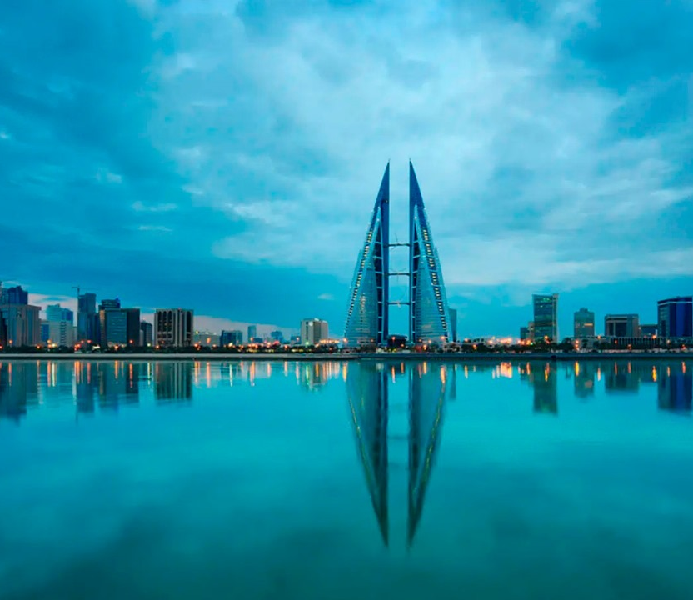
ABOUT
Our company, founded in 2024, is the largest supplier of lumber to MENA countries.
We offer a wide range of products of the highest quality, including lumber of various coniferous and hardwood species from Russian Federation.
A company with global aspirations.
The strategic goal of NEBULA NEXUS is to become one of the leaders among trading companies, through the development of new markets, diversification of activities, and ensuring reliability of supplies.
As a truly customer-oriented seller, we offer products of the highest quality that meet international standards, environmental safety and management.

Slide 3
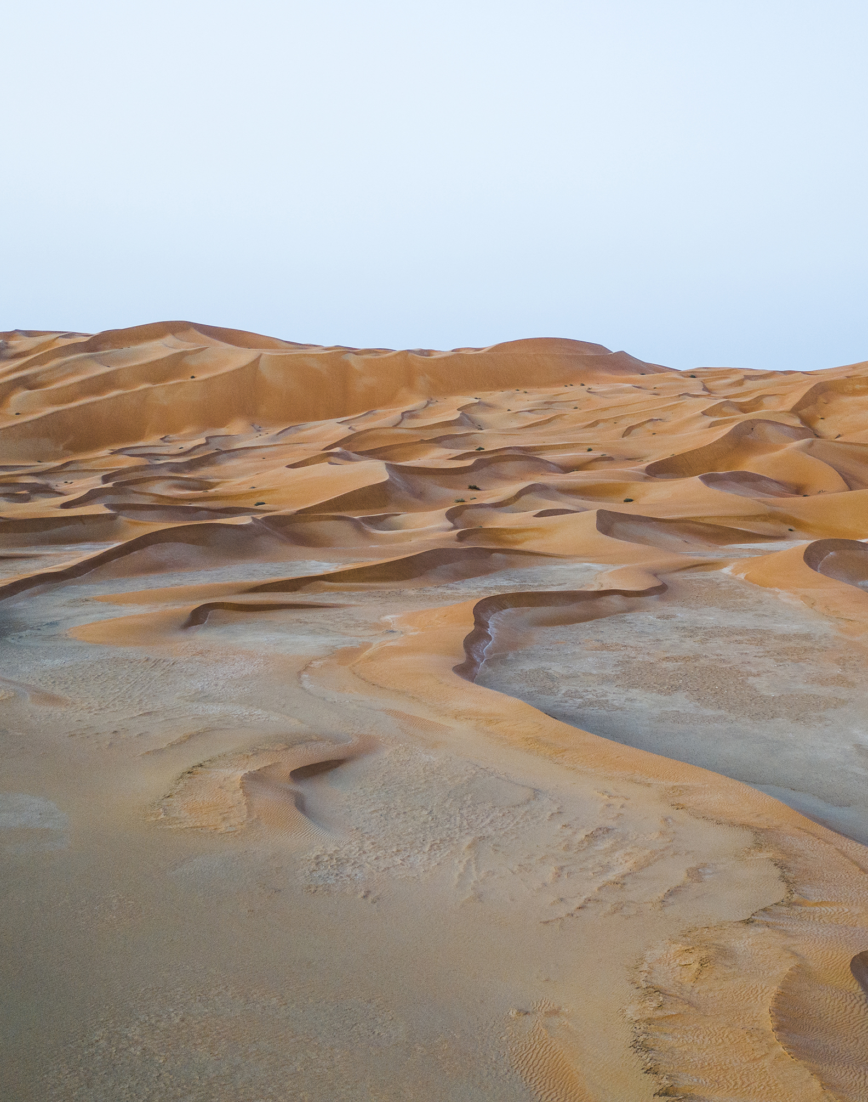
MISSION
to bring good by providing values that meet the needs and expectations of society now and with care for the future generation..
to be a worthy, competitive, world-class Company,
to ensure balanced business growth and the preservation of a favorable environment,
to be guided in its activities by high quality standards, careful attitude to natural resources and the principles of high responsibility.

Slide 4
STRATEGY
Ensure continuity and reliability of lumber supplies to the countries of the Arabian Peninsula and the African continent.
Expand the geography of our business.
Opening new business areas aimed at meeting demand..
Optimization of business processes..
Increasing the company's capitalization..

Slide 5
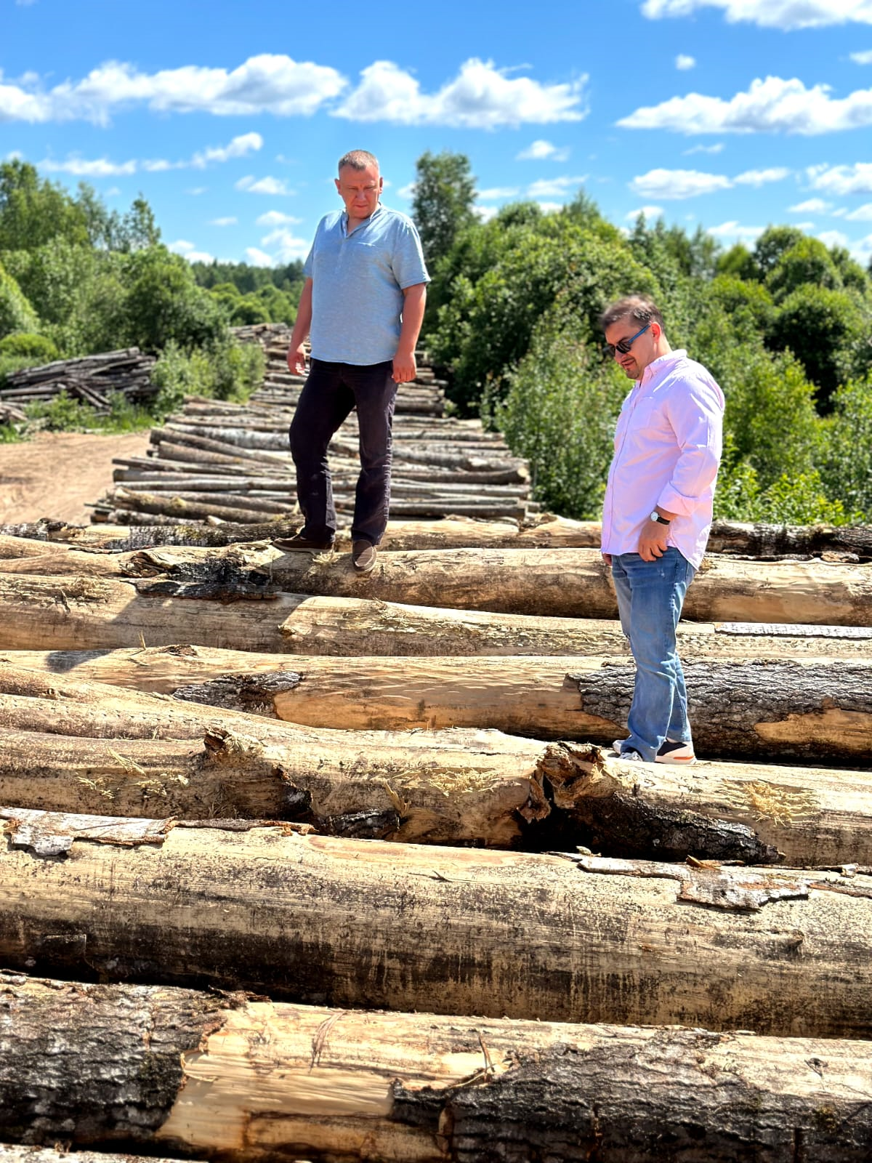
Our advantages
Our reputation is based on product quality, reliable supplies and impeccable service to all our customers.
Financial and legal transparency.
Punctuality and clarity of fulfillment of obligations.
A team of professionals. The best in their field.
We adhere to the highest standards of responsible forest management.
Only environmentally friendly lumber.

Slide 6
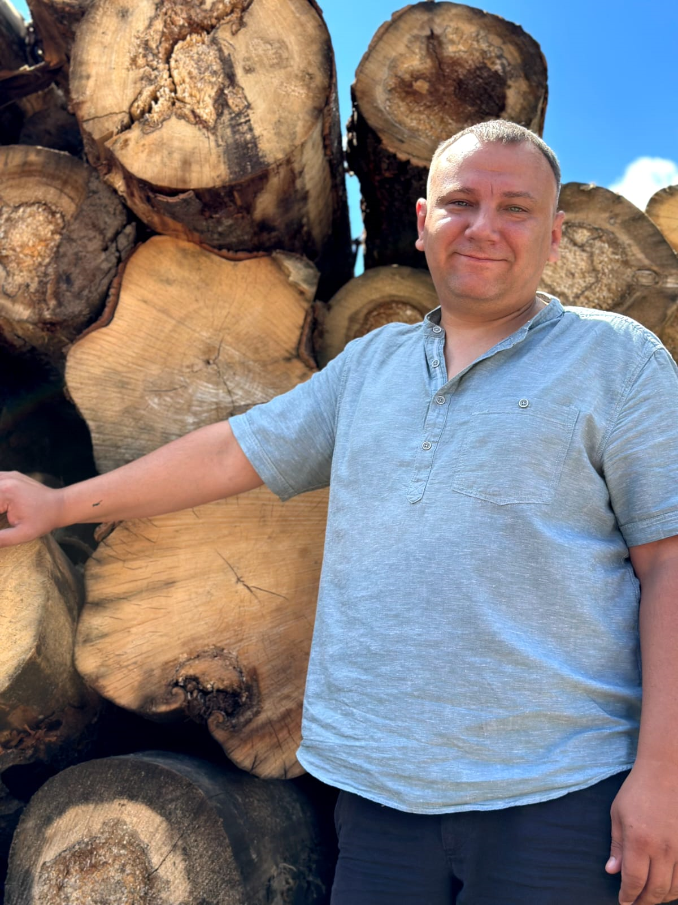
Company goals
Meeting customer needs for high-quality Russian wood products;
Diversification of the product portfolio;
Maximizing the value of the company;
Creating an economically strong and independent company.

Slide 7
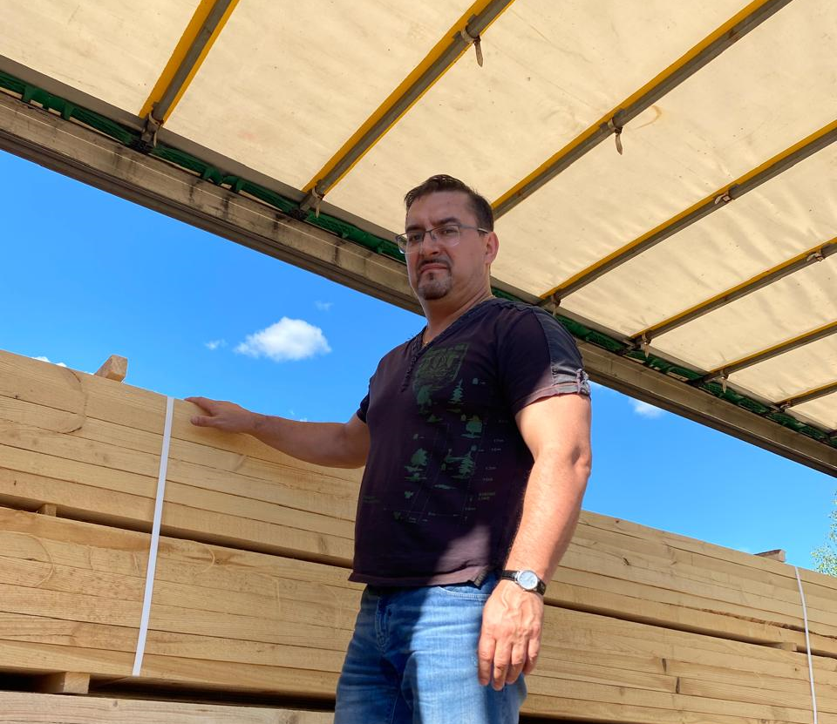
Geography and experience of supplies
Our products are exported to more than 30 countries on 3 continents.We ship finished lumber from the factory by road, rail, river and sea transport:
Finland
Baltic countries
China
Middle East
Russia
Egypt
India
Southeast Asia

Slide 8
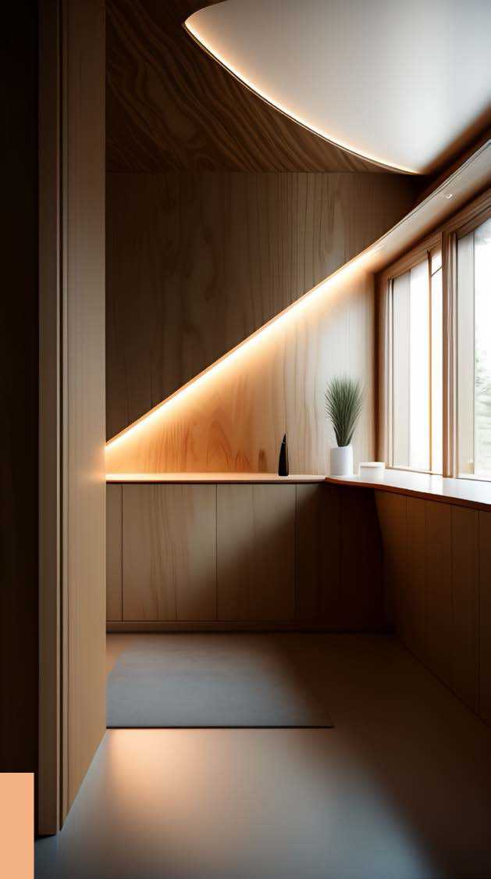
About the factories
Our plants are located in the northwestern economic zone of the Russian Federation and are manufacturers of plywood, latoflex and lumber. They are one of the oldest enterprises in Russia, leading its history since the end of the XIX century.
We are constantly upgrading and increasing our production capacity. This allows us to significantly increase the range, volume and quality of our products.

Slide 9
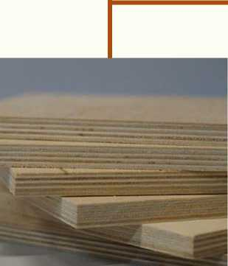
The main types of products produced
MR and WBP
Format 1525x1525 Thickness 2,4 - 30 mm Sort 1/2 - 4/4 Surface polished, unpolished
WBE
Format 2440x1220/2500x1250 Thickness 4 - 24 mm Sort 2/2 - 4/4
Laminated WBP
Format 2440x1220/2500x1250 Thickness 6 - 24 mm Sort 1/1 - 3/3
Latoflex
Length 600 - 1590 mm Thickness 8, 9, 10, 12 mm Width of 25 mm or more
Lumber (needles)
Planed board Lining
Balks imitation
All plywood and latoflex are made of birch

Slide 10
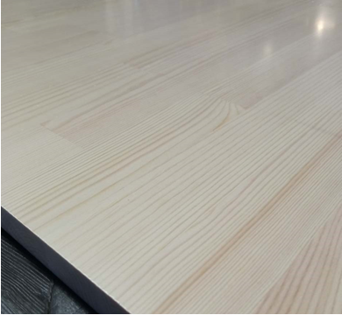
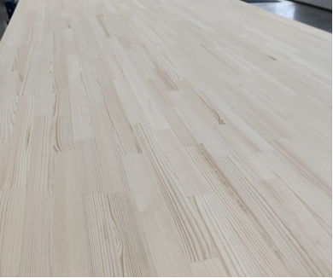
Furniture board (Solid-panel /spliced shield).
Product Description: The furniture board is made of pine wood.
Place of production: Karelia (North, Russian Federation).
Grade: AA (spliced, without knots and other defects). Each product is packed in a transparent film.
Application: for the independent manufacture of furniture (both facades and interior elements), shelves, countertops, window sills, stairs, as well as the formation of the interior of apartments and country houses.

Slide 11
Full cycle production
10,000 trees are planted annually
Logging takes place on our own plots
Veneer peeling and sorting
Plywood pressing and grinding

Slide 12
Grade B (1): practically free of defects. Partially fused, non-fused, falling out knots and holes from them are allowed. As well as minor streaks, healthy discoloration
Grade BB (2): defects listed in Grade 1, but in larger quantities, it is allowed to repair the surface of the sheet with inserts of their veneer
Grade CP (3): defects listed in Grade 2, but in larger quantities, as well as healthy fused knots without restriction
Grade C (4): Any manufacturing defects are allowed. Stratification is not allowed
It is used in construction and furniture production
nebnexbh.com

Slide 13
 | <« • ■ i,
 | w* §1.3 : £
Grade B (1): visible damage to the outer layer is excluded, spots up to 25x25 mm are possible in the calculation of 1 piece / sq.m, point distortions of the structure, film blisters, squeezing from plates and debris are unacceptable
Grade BB (2): overlaps are allowed, the absence of up to 1% of the outer film coating, signs of defects in the inner layers of the veneer, spots and stripes, painted chips, no more than 10% change in structure without signs of damage to the lining
Grade CP (3): there may be no lining and overlay film, the presence of spots and stripes, stuck fragments of film on top, scratches, debris prints, chips

Slide 14
The board is dry
From pine and spruce
Lining
Balks imitation
Wood balancees and naturally

Slide 15
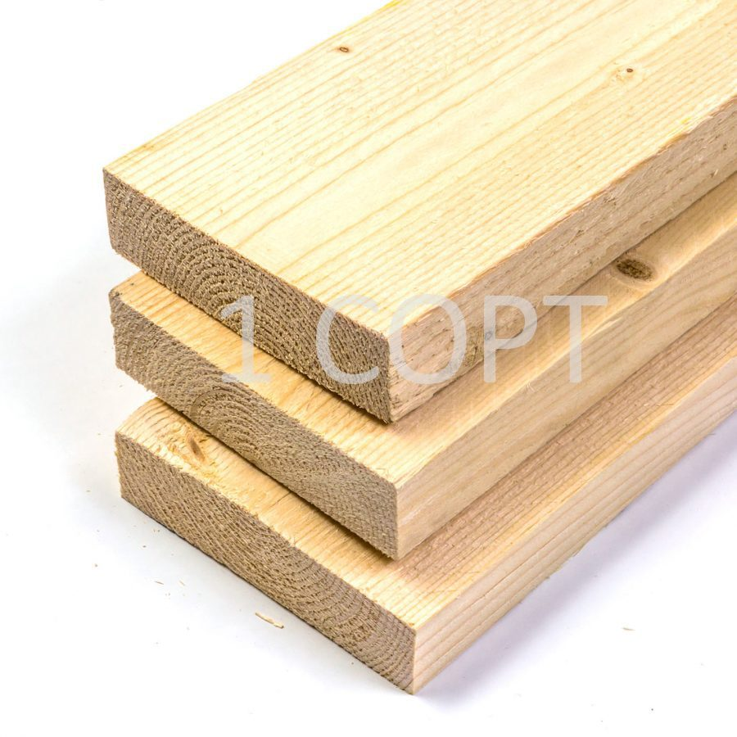
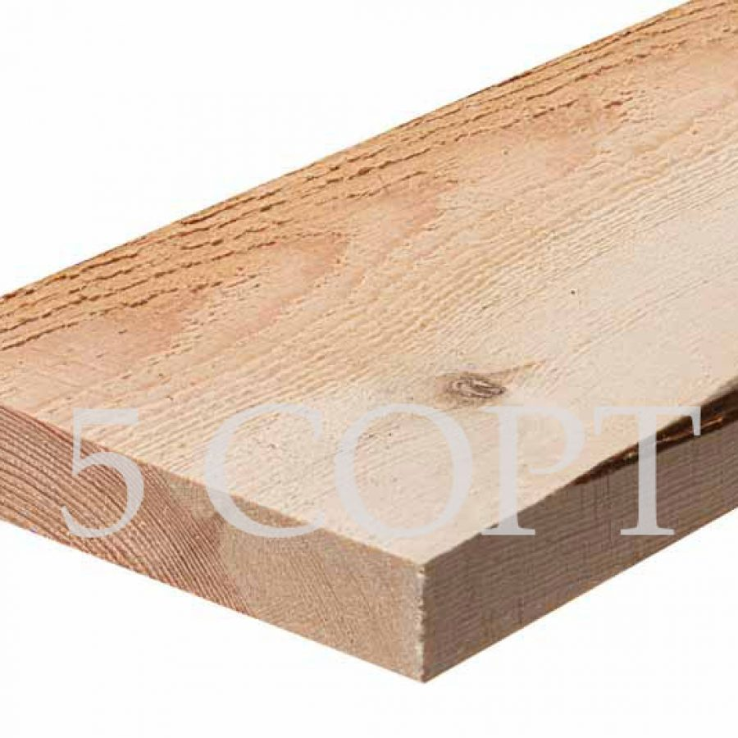
EDGED BOARD, SPRUCE and Pine
GRADE 1-3; 4, 5
LENGTH, m
Grade 1-3: 3.0 – 6.0 with a gradation of 0.3
4-5 grade: 1,2-2,4
HUMIDITY, % 8-22, chamber drying
THICKNESS, mm 16-195
WIDTH, mm 50-195

Slide 16
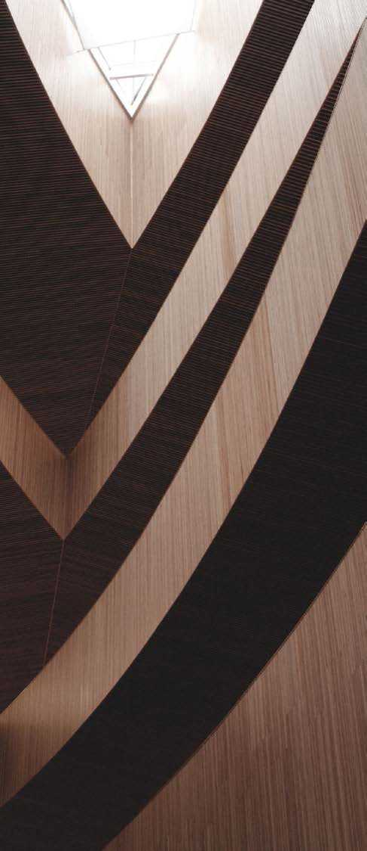
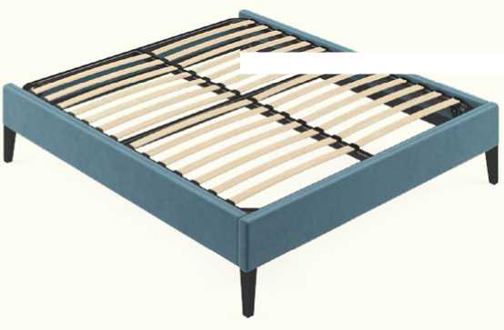
Latoflex
Furniture parts that can be manufactured in various sizes and parameters based on the customer's wishes.
Length:
- the maximum length of the bent flex is 990 mm (radius 3,600 mm)
- the maximum length of the straight flex is 1,590 mm Width: from 25 mm and more
Thickness: 8, 9, 10, 12 mm Surface: natural, dyed, with paper Color: natural, film color, beech
%v

Slide 17
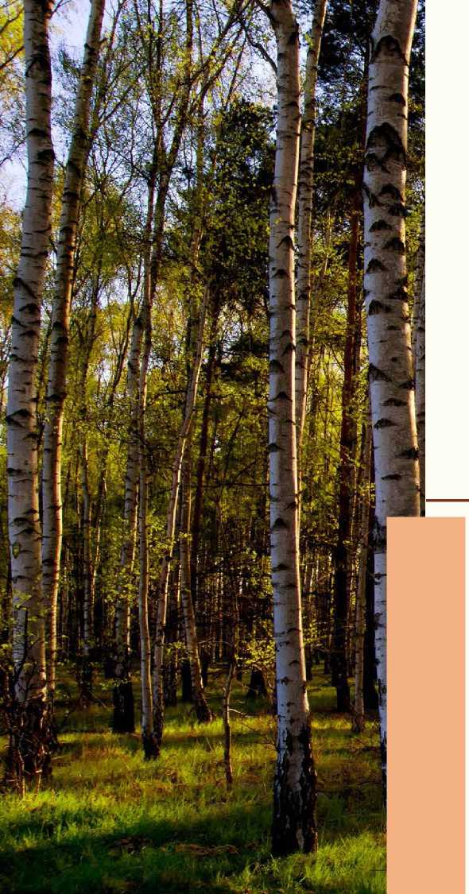
Our efforts are aimed at creating innovative and high-quality solutions in the field of woodworking. We are constantly implementing best practices and approaches to ensure that our products meet the highest standards of efficiency and reliability.
We will be happy to help you find exactly the product that meets your needs. Our team of professionals is ready to provide expert advice and support in choosing the optimal solution for you.
www.nebnexbh.com
+973 341 529 77
info@nebnexbh.com
Address: Building 60, Road 1701, Block 317 Diplomatic Area, Manama, Bahrain

